Slide 1
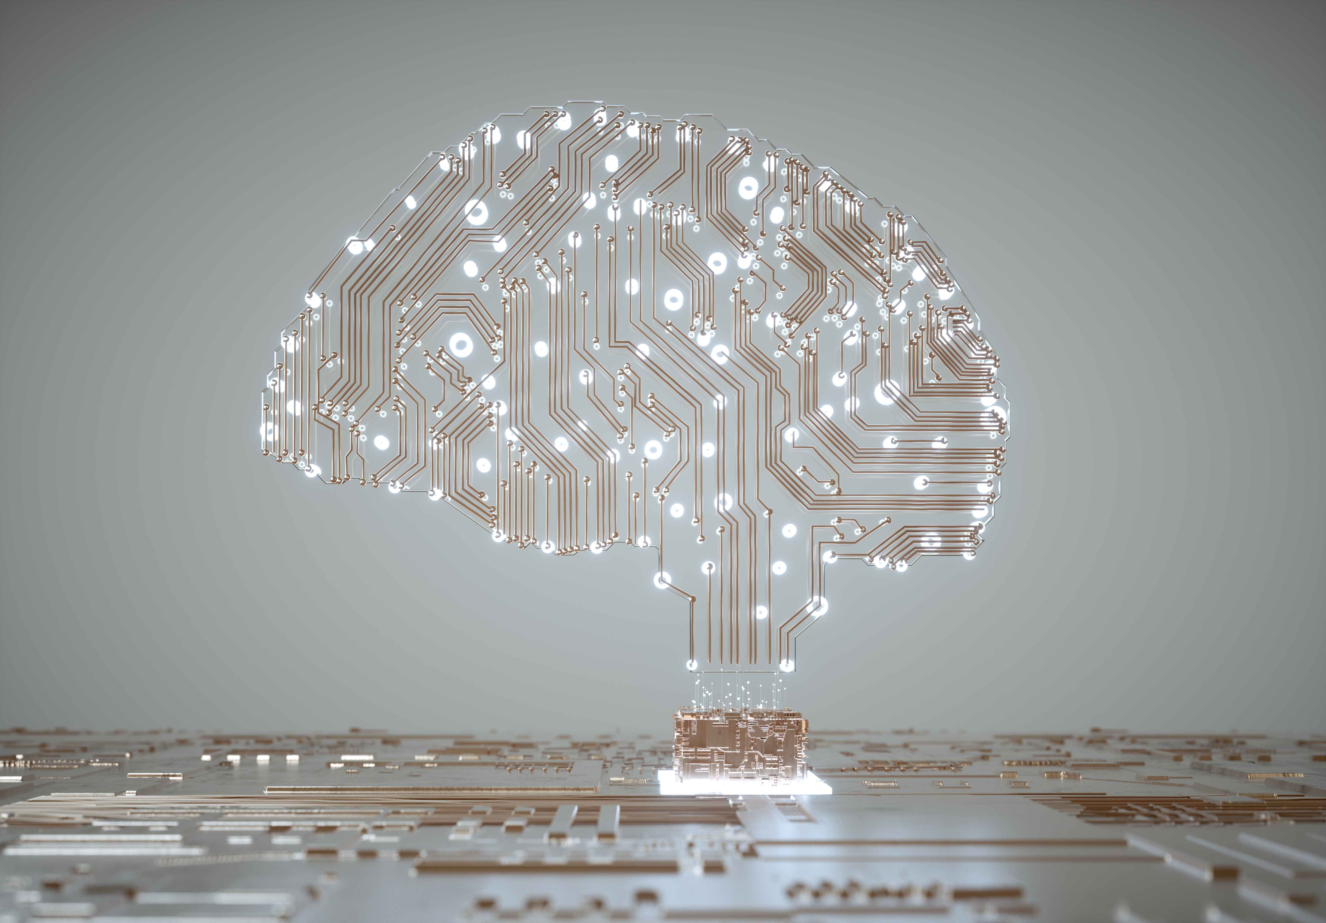
AWS AI Services
Vivek Raja P S Data Scientist, Nexstem

Slide 2


About me
From Madurai, Tamil Nadu
Data Scientist @ CortexBCI Inc | Nexstem
Co-Organizer at AWS User Group – Chennai
15x Multi—Cloud Certified
20 times International & National Hackathon winner
Published 5+ Research papers, + 1 patent (AI & IoT)
Active Speaker, Mentor, Blogger, Open-source Contributor and organizer of various AI & Cloud related developer communities across India.
@VivekRaja007

Slide 3
Agenda
What are AWS AI Services?
Overview of the AI Services
Demo
Resources

Slide 4
Are you
New to Machine Learning?
An application developer who wants to leverage AI services?
ML enthusiast with limited knowledge?
AI expert who wants to build quick accurate AI models?

Slide 5
AWS Artificial Intelligence Services
Ready-made intelligence for your applications and workflows for common use-cases with quality and accuracy from continuously-learning APIs.

Slide 6
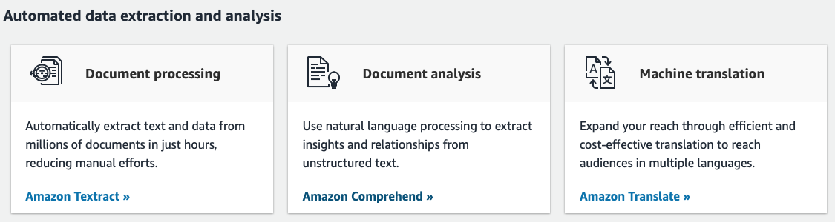
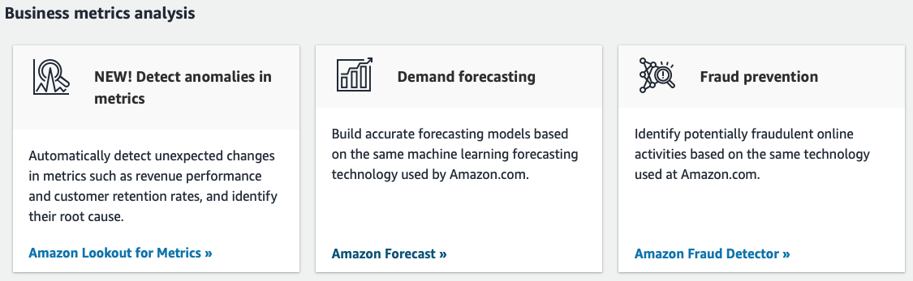

Slide 7
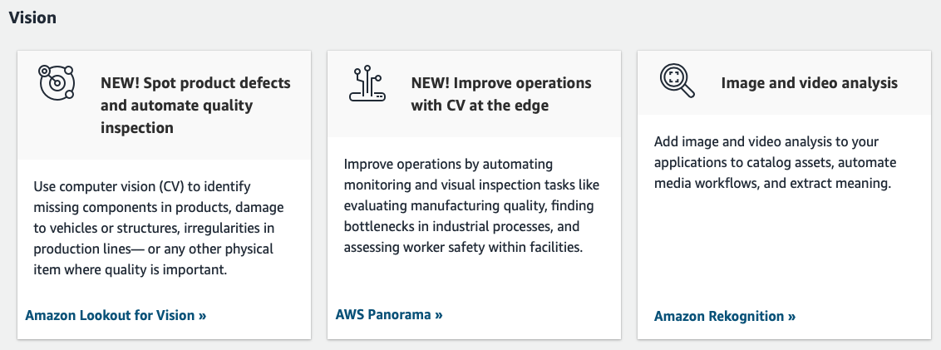
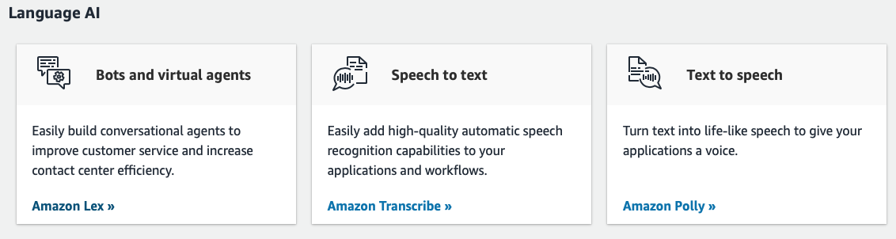

Slide 8
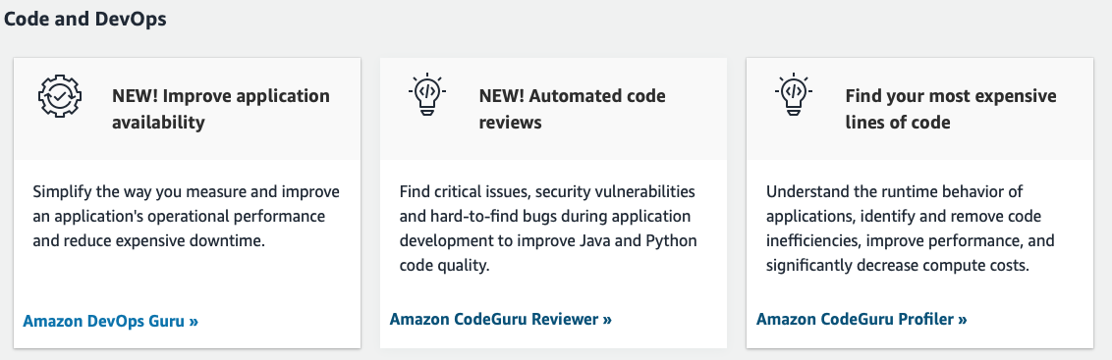
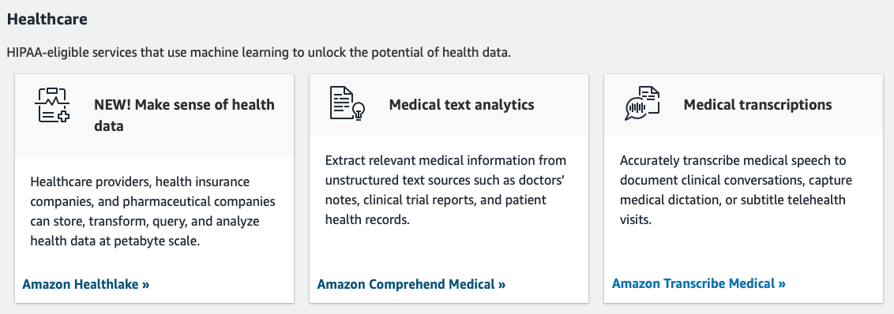

Slide 9
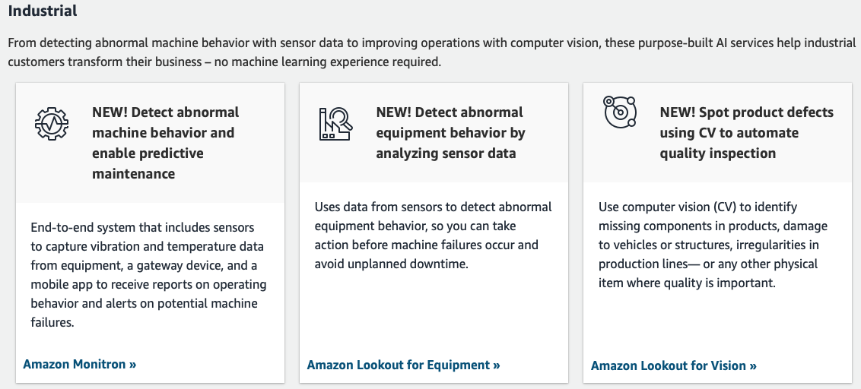
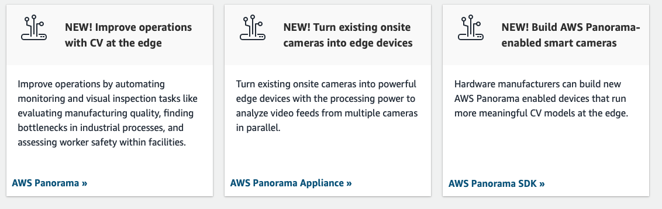

Slide 10
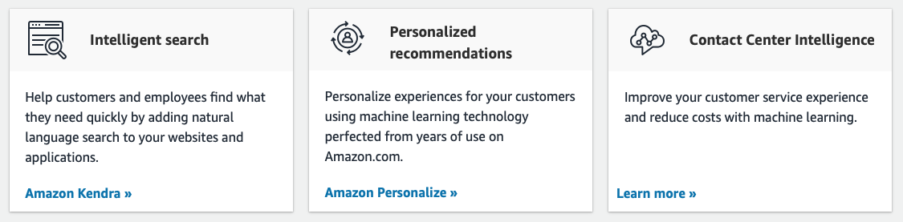
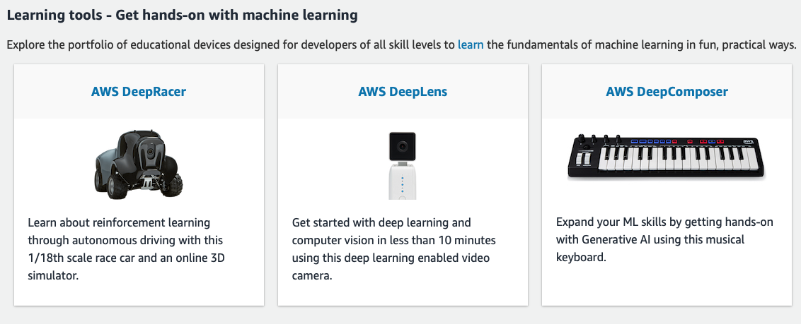

Slide 11


Check out my
GitHub – for awesome AI repos
Medium - Interesting blogs on AI related use-cases
Connect with me!
Linkedin: @Vivek Raja P S

